Slide 1


University of North Carolina at Charlotte
DSBA/MBAD 6276 Consumer Analytics
Marketing Strategy for Charlotte Football Club

Slide 2
Project Team - 3
Ziyin Liu
Muthu Priya
Marianne Rojas Abinader
Karan Edikala
Cameron Shadmehry

Slide 3
Background Research
Major League Soccer (MLS) was founded in 1993 & is headquartered in NYC.
MLS stands as the 3rd highest attended sports game in US and 7th highest worldwide in Soccer games.
26 MLS teams in US and 3 MLS teams in Canada.
Charlotte FC was granted franchise in December 2019 & owned by David Tepper.
Riley McGree, Sergio Ruiz are the two players signed up for the team.
Location: Bank of America Stadium in Charlotte, North Carolina.
Competitors: FIFA, CONCACAF, NFL, NHL, etc.

Slide 4
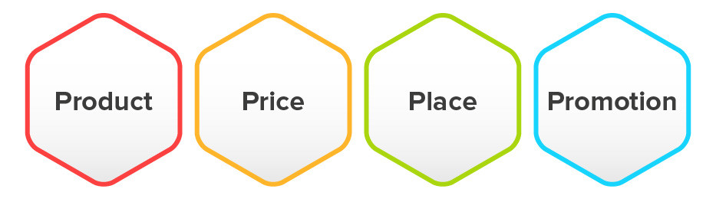
Marketing Strategy - 4P’s
Product – Games, Players, Team Strategy
Price – Sponsors Investments, Brand Ads, Tickets fare
Promotion – TV Ads, Flex & Posters, Social Media, Giveaways
Place – Stadium
Target Audience: Students, Teenagers, Adults

Slide 5

Marketing Problems
The primary goal: Increase the MLS ticket sales for the Charlotte Football Club.
How: Analyzing survey results and the segments interested in attending the stadium.
Students: Offer student discounts at a lower rate while keeping the quality high for those who would pay additional for a game.
Other segments: Favorable ticket rate.
Notes:
Marianne
The main goal of this project is to find a way to increase the MLS ticket sales for the Charlotte FC
In order to do so we conducted a survery and we analyzed the results along with the segement interested in attending the bank of america stadium
For our student segments we plan to offer student discounts to be at the lower right that they need specially since they don’t have a job but while keeping the quality high for those who would pay additional for a game.
For other segments we plan to have a competittive but favorable ticket rate based on the responses.

Slide 6
Research Objective
Discover what would drive an individual to attend the Charlotte FC games and accomplish the following objectives:
Identify competitors and their ticket sales prices to target our segments.
Determine what influences our target market to purchase sports game tickets.
Identify the competitor's strategies and what drives ticket sales.
After steps 1 and 2, we will determine the best sale prices and event strategies for the upcoming 2022 season by analyzing the target market's perceptions and preferences.
Identify a marketing strategy for increasing ticket sales and attendance.
Notes:
Marianne -
For those who have played soccer in the past, soccer is a priority for them. For those who have a shallow interest in soccer or have never played before, getting people interested in attending the games could be challenging considering the competition in the Charlotte area. We plan on gaining an understanding of what would drive an individual to attend the Charlotte FC games and accomplish the following objectives:
Identify competitors and their ticket sales prices to target adults, teenagers, and college students.
Determine what influences our target market: teenagers, adults, and college students to purchase sports game tickets. This will help identify the competitor's strategies and what drives the different segments to buy tickets.
After steps 1 and 2, we will determine the best sale prices and event strategies for the upcoming 2022 season by analyzing the target market's perceptions and preferences.
We will identify a marketing strategy for Charlotte FC ticket sales targeting teenagers, adults, and college students against the competitors.

Slide 7

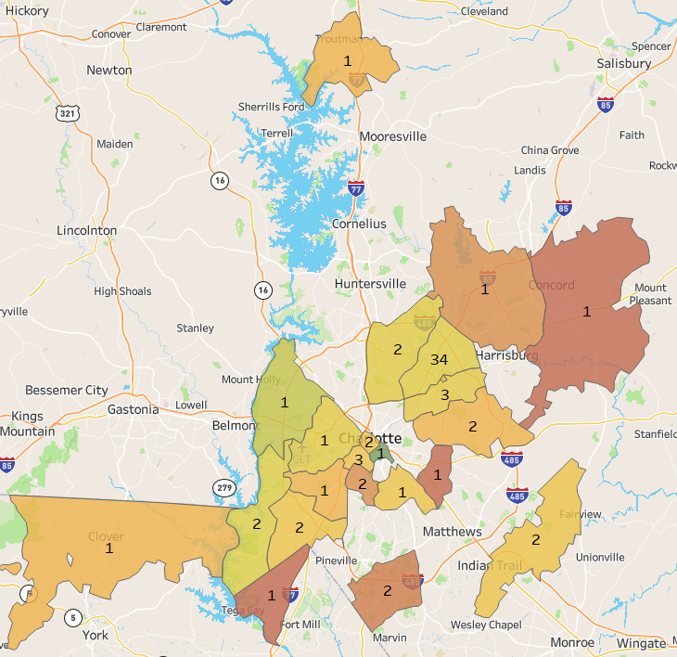
Data Preparation and Preprocessing
80 participants.
14 questions In the survey:
Characteristic variables
Demographics variables
Preference of games
Most of participants are living close to one area
( zip: 28262 ).

Slide 8
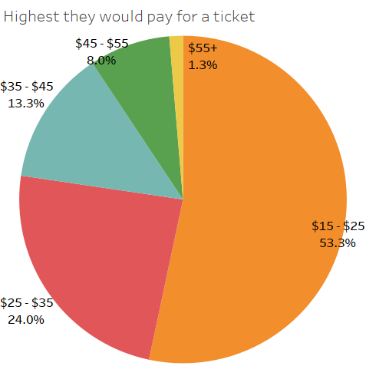
Data Preparation and Preprocessing
Most of the participants are college students ( age between 21 and 40 ) , gender ratio is 6:4 ( F:M ). Almost 20% participants have no incomes.
62.5% participants have not been to the BOA stadium. 68.9% participants are willing to attend future games .
More participants are expecting lower ticket pricing.

Slide 9
Analysis Method
Preprocess the Survey Data
Correlation Analysis
Clustering
Logistic Regression

Slide 10
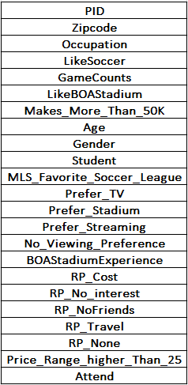
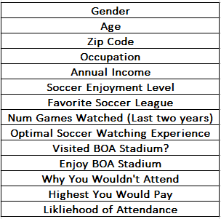
Analysis Result - Preprocessing

Slide 11
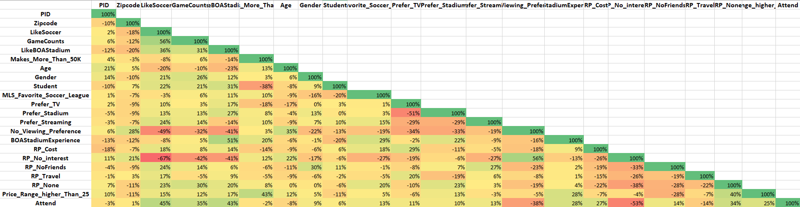
Analysis Result - Correlation
Like Soccer -> Game Counts (56%)
Like BOA Stadium -> BOA Stadium Experience (51%)
Reason Preventing is “No Interest” -> Likelihood to Attend (-53%)

Slide 12
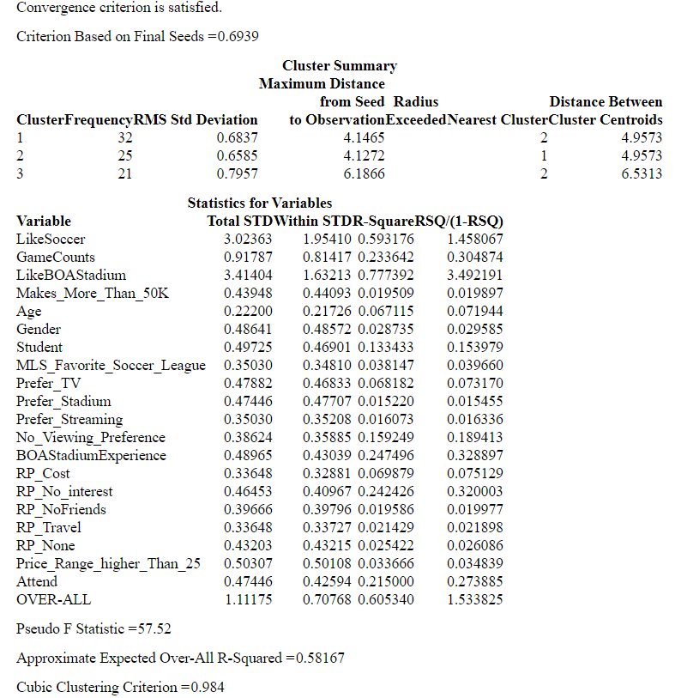
Analysis Results - Cluster Analysis

Slide 13
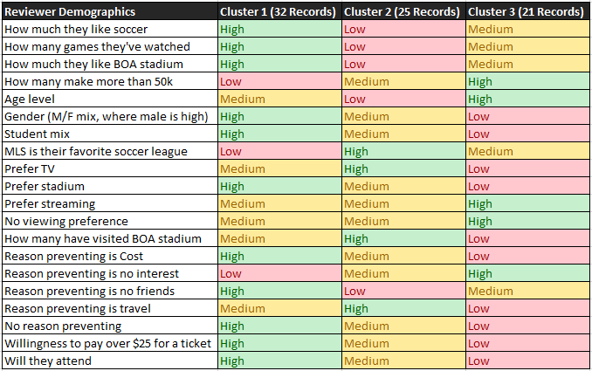
Analysis Results - Cluster Analysis
Cluster Summaries
Cluster 1 | Cluster 2 | Cluster 3
Majority male students Enjoy soccer the most Make the Least $ MLS least fav. Prefer to watch at the stadium RP is friends Willing to pay the most Likely to Attend | Like soccer and BOA the least amount Youngest people MLS is their fav. League Prefer to watch on TV RP is travel Somewhat willing to pay over $25 Somewhat willing to attend | Majority female Make the most $ Oldest people Prefer to stream or not watch RP is no interest Least likely to pay over $25 Least likely to attend

Slide 14
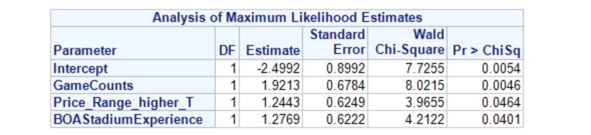
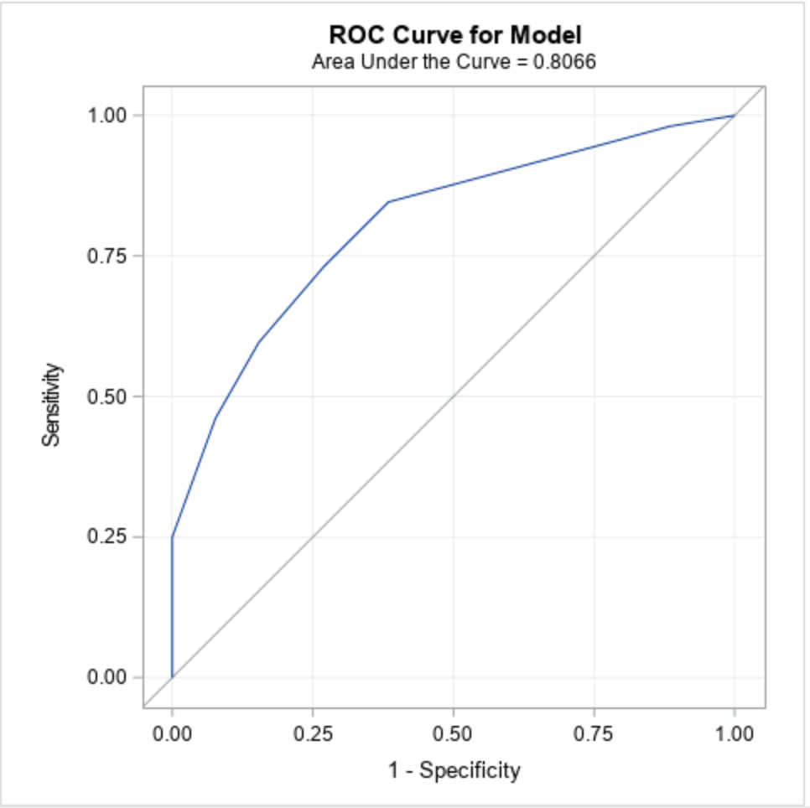
Analysis Result - Logistic Regression

Slide 15
Marketing Strategy Recommendation
Market using the customer segments achieved from clustering:
Target students (male students if possible)
Charge them $25 per ticket and entice students with group deals (Ex: a group of 3 or more can get a discount).
Market cheaper tickets to the younger people who may or may not be students.
Market the least amount to older women who make over $50,000. (Note this insight may change with more data, ours was heavily distributed to UNCC students and teachers).
Target people who already visit the stadium during the football season (possibly a joint season ticket package with the Panthers).
Notes:
Field days would increase stadium attendance and might even recruit customers (kids, parents) that would normally not go to a stadium. Individuals that attended the stadium before are more likely to go to a game.

Slide 16
Marketing Strategy Recommendation
Average regular season MLS ticket price is $49 in 2019. Charlotte FC should align.
Partner with schools for field days.
Notes:
Field days would increase stadium attendance and might even recruit customers (kids, parents) that would normally not go to a stadium. Individuals that attended the stadium before are more likely to go to a game.

Slide 17
References
Charlotte MLS Team: https://charlottefootballclub.com/our-club/
Predictive Sporting Event Ticket Pricing: https://mosaicdatascience.com/2019/10/28/predictive-ticket-pricing-blog/

Slide 18
Thank You!
By,
Team - 3

